Slide 1

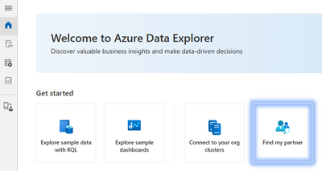
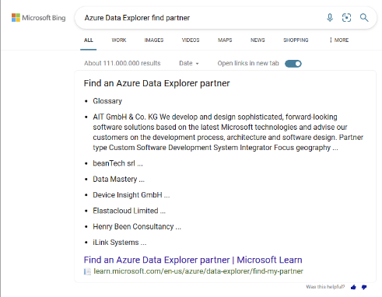
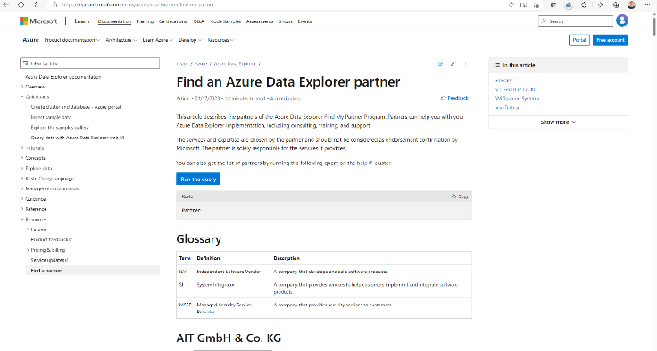
Find my partner
Connect customers with partners
Azure Data Explorer homepage
Azure docs
Help cluster
| join us: kuspart@microsoft.com

Slide 2
Persistent Storage & Caching
All data is stored in blob storage for durability, some of the data is cached on the local disk. The operating system caches recent accessed data in the RAM.
Retention policy defines the lifetime of the data. When the retention period expires (and in some cases after additional 14 days of recoverablity), the data is permanently deleted.
Caching policy defines the data that should be kept on the local disk
Hot cache = Local disk (SSD)
Cold cache = A portion of the disk that is kept for caching the latest data retrived from the cold storage.
Cold data = The data in blob storage that is not cached on disk
Data queried often should *always* be in hot cache
Cold Data should only be used for “point queries” or for rarely accessed data

Slide 3
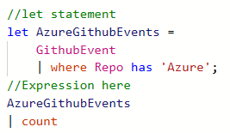
Let statements
Essence: Named expression or function, defined and used in a query scope
Usage examples:
let foo = T | where … ;
let bar = (val:string) { … };
Schema: scalar or tabular
Special powers: Can override table / stored function with the same name
Applications:
Reusing language expressions
Mid-tier exposing Logical Model (see also: restrict)

Slide 4
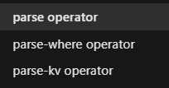
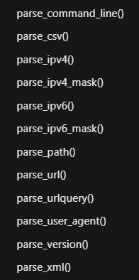
Parsing
Parsing can be done with regular expressions as well as with native functions for specific data types and patterns
Parsing operators return data in columns
Parsing functions return dynamic objects using JSON notation
Applications:
Parse complex JSON, XML documents
Extract IP addresses, URLs
Extract key-value pairs
Notes:
<Guy>

Slide 5
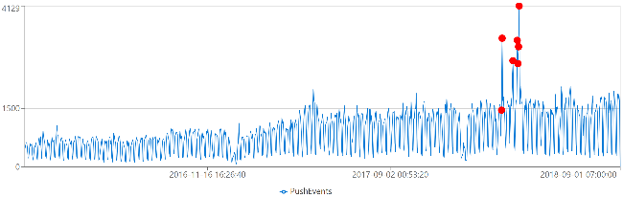
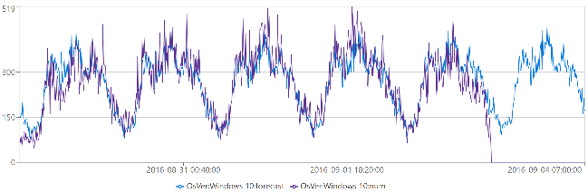
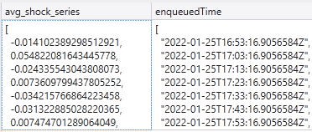
Time Series Analysis
T | make-series operator for creating set of (time) series
Large family of functions can be applied on set of time series:
Element-wise operations
Filtering (signal processing)
Statistics
Regressions
Seasonality detection/validation
Anomaly Detection
Forecasting
mv-apply operator
Series functions are optimized for bulks of time series
Notes:
<Hiram>
ADX performs on-going collection of telemetry from cloud services or IoT devices. This data can be analyzed for various insights such as monitoring service health, physical production processes, and usage trends. Analysis is done on time series of selected metrics to find a deviation in the pattern compared to its typical baseline pattern.
From <https://learn.microsoft.com/en-us/azure/data-explorer/kusto/query/time-series-analysis>
simply and intuitively using the make-series operator, and fill-in missing values as needed
Element-wise functions: Arithmetic and logical operations can be done on a time series. Using series_subtract() we can calculate a residual time series, that is, the difference between original raw metric and a smoothed one, and look for anomalies in the residual signal.
Filtering - smoothning a noisy signal, change detection, simple calc of moving average and differentiation. ie. Series_fir(), series_iir(), bins (s/m/d)
Statistics - percentile, standard deviation, mean/min/max/avg/count.
Regressions, segmented linear regression to estimate the trend. series_fit_line() - fit the best line, series_fit_2lines(), detect changes relative to baseline.
Seasonality - auto detect periods/clusters, series_periods_detect(), series_periods_validate() - check if a metric has a specific period and we want to verify they exists.
Anomaly detection - uses series_decompose() and series_outiers() on the residual. Finds seasonal, trend, residual, and baseline. Calculates anomalous points using Tukey's fence test. Control threshold sensitivity. Forecasting is done by extrapolating the seasonal and trend components.
mv-apply operator Applies a subquery to each record, and returns the union of the results of all subqueries. From <https://learn.microsoft.com/en-us/azure/data-explorer/kusto/query/mv-applyoperator>
What is time series analysis?
Time series analysis comprises methods for analyzing time series data in order to extract meaningful statistics and other characteristics of the data. Time series forecasting, for example, is the use of a model to predict future values based on previously observed values.
What is time series decomposition? Time series decomposition involves thinking of a series as a combination of 4 components:
trends (increasing or decreasing value in the series)
seasonality (repeating short-term cycle in the series)
baseline (the predicted value of the series, which is the sum of seasonal and trend components)
noise (The residual random variation in the series). We can use built in functions, that uses time series decomposition to forecast future metric values and/or detect anomalous values.
This is what time series looks like: <click>
Why should you use series instead of the summarize operator ? The summarize operator does not add "null bins"—rows for time bin values for which there's no corresponding row in the table. Advanced built in ML capabilities like anomaly detection, need the data points to be consistently measured at equally spaced intervals, so we have to "pad" the table. The make-series can create such a “complete” series.

Slide 6
python plugin: KQL extensibility with inline Python
Python engine run on secure local containers on the same Kusto compute nodes
Image is based on Anaconda 5.2.0 + popular packages (tensorflow, keras, torch and more)
Execution on single node (default) or distributed processing
Ability to install custom packages
Support for scoring with big ML models
Editing & Debugging with VS Code (client-side integration)
Notes:
<Hiram>
DEMO
Here's the KQL script I demo'ed: ADXIoTAnalytics/ADXInADay-DemoML.kql at main · Azure/ADXIoTAnalytics (github.com)
This KQL script includes options and addition ML training guides: ADXIoTAnalytics/M06-Demo5-TrainModel.kql at main · Azure/ADXIoTAnalytics (github.com)

Slide 7
ML Connectivity
Jupyter/Azure Notebooks with KqlMagic extension
Connect multiple clusters (Kusto, Log Analytics, App Insights)
Create rich interactive notebook with Kusto and Python
Use out-of-the-box integration with Python visualization libraries
Notes:
<Hiram>

Slide 8
ML Connectivity
Python & R Client SDKs
Access data from Kusto using Python or R libraries
Spark connector
Read data or write data to Kusto using Scala and PySpark
Parquet support
Ingest parquet files from Blob/Data Lake
Export data to Blob/Data Lake as parquet files (with partitioning support)
External tables
Query parquet files from data lake as external
Notes:
<Hiram>

Slide 9
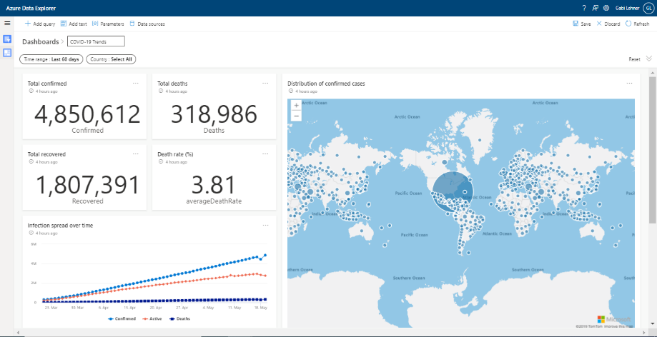
ADX Dashboards
Dashboarding integrated into the ADX web explorer
Free offering for ADX customers
Performance focused
Advanced filtering capabilities:
focus on big data scenarios (free text)
cascading filters to improve filtering experience
ADX integration
Native integration with KWE to allow query pinning to dashboards and tile exploration
Parameters – parameters injection to queries to boost performance
Notes:
<Guy>

Slide 10
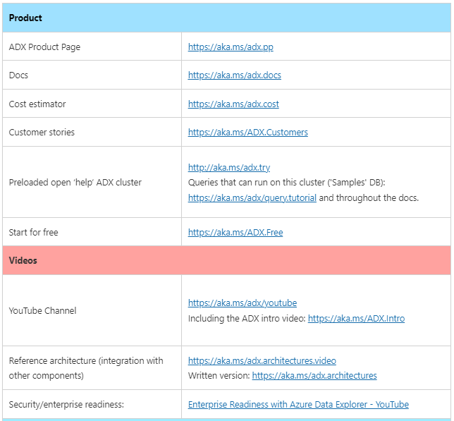
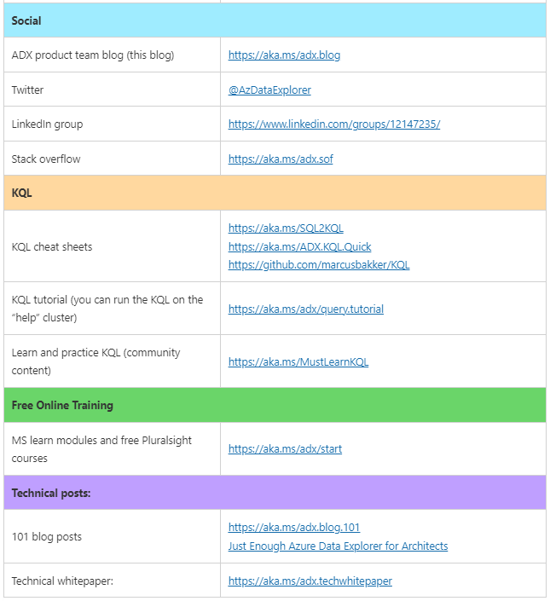
https://aka.ms/ADX.links

Slide 11
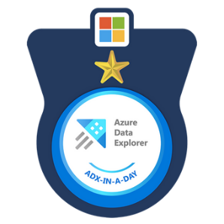
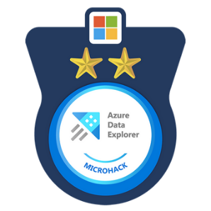

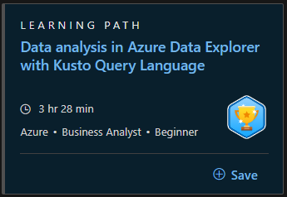
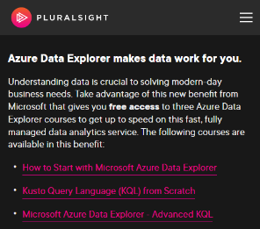
ADX Learning Programs
ADX-in-a-Day
ADX Microhack
Kusto Detective Agency
MS Learn module on Azure Data Explorer
Pluralsight Course on Azure Data Explorer

Slide 12
ADX Partner Program
Free POC for ADX/SDX resources
No charges on the Kusto resources
Well defined POC scope and goals
https://aka.ms/adx.freepoc.request
Partner ECIF for AMD powered deployments
AAAP ECIF offer & blog post
Training, upskilling and technical backup during projects
Find my partner
Connect customers and partners faster
| join us: https://aka.ms/adx.partnersinfo

Slide 13

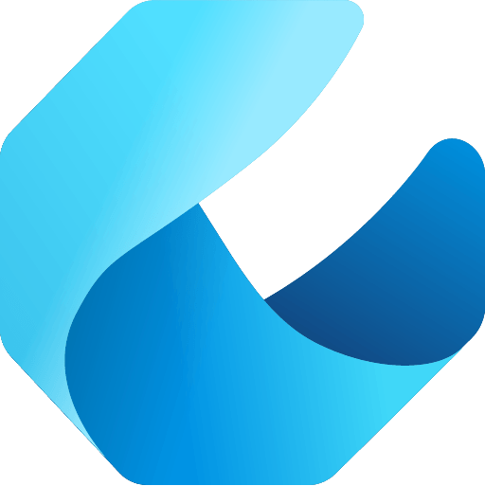

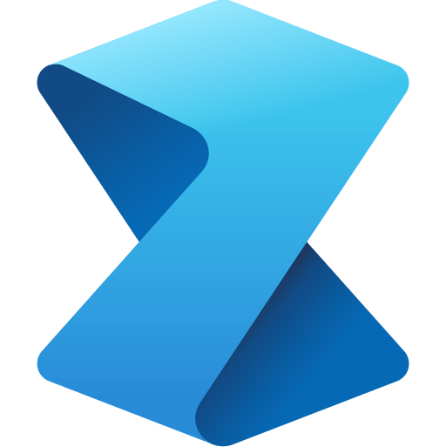

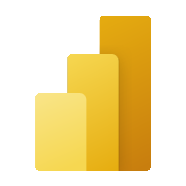


Microsoft Fabric does it all—in a unified solution
An end-to-end analytics platform that brings together all the data and analytics tools that organizations need to go from the data lake to the business user
Data Integration
Data Engineering
Data Warehouse
Data Science
Real Time Analytics
Business Intelligence
Observability
Data Factory
Synapse
Synapse
Synapse
Synapse
Power BI
Data Activator
Unified data foundation
OneLake
UNIFIED
SaaS product experience
Security and governance
Compute and storage
Business model
Notes:
Microsoft Fabric combines Data Factory, Synapse Analytics, Data Explorer, and Power BI into a single, unified experience, on the cloud. The open and governed data lakehouse foundation is a cost-effective and performance-optimized fabric for business intelligence, machine kerning, and AI workloads at any scale. It is the foundation for migrating and modernizing existing analytics solutions, whether this be data appliances or traditional data warehouses.
Talk Track for Greenfield/Growing Analytics Customers – Microsoft Fabric’s SaaS environment makes it easier to deploy an entire end-to-end analytics engine from the ground up at an accelerated pace. With the solution’s built-in security and governance capabilities, you can be rest assured your data and insights are protected.
Talk Track for Existing Synapse Customers – Microsoft Fabric is an evolution of Azure Synapse. You will still be able to enjoy the benefits and limitless scale of Synapse in an easier to use SaaS solution while adopting new capabilities that enhance your entire analytics approach. And with the addition of Power BI, you can help democratize the ability to uncover insights and create interactive reports across the organization, helping everyone make more data-driven decisions in their everyday work.
Talk Track for Existing Power BI Customers – With Microsoft Fabric, you’ll be able to access new and powerful data tools and services like Azure Synapse within the same user experience you already enjoy with Power BI. You can unify these tools with your disparate data sources in the same environment to establish a single source of truth for all data, driving the ability for everyone to uncover more accurate and consistent insights than before. And instead of having to worry about security concerns of a patchwork analytics estate, you can be rest assured your data is protected with the built-in security and governance capabilities.

Slide 14
Get started today
Explore the product here: https://aka.ms/try-fabric-rta
Get your questions answered in the Microsoft Fabric webinar series: https://aka.ms/fabric-webinar-series
See the latest announcements in the Microsoft Fabric blog site: https://aka.ms/fabric-tech-blog
Reading the official documentation on Real-Time Analytics: https://aka.ms/fabric-docs-rta

Slide 15

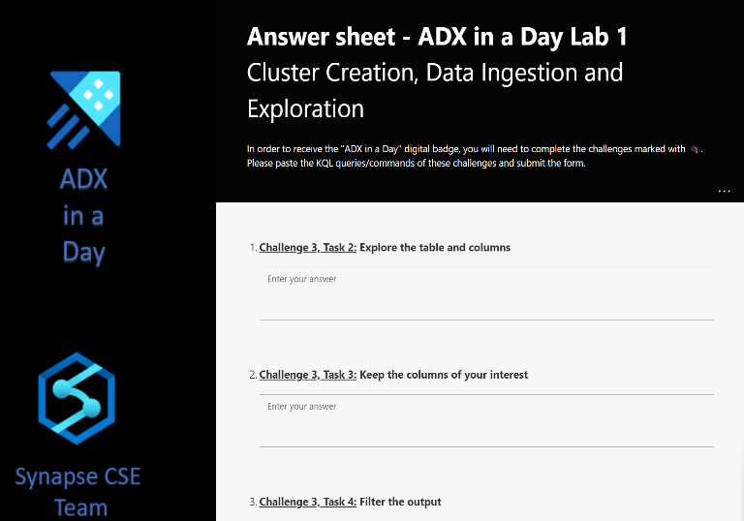
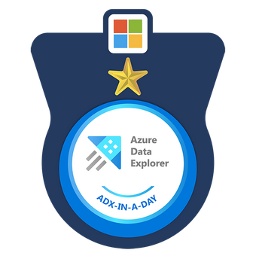
ADX-In-A-Day resources
ADX in a Day – GitHub page
Answer sheet forms
Lab 1
Lab 2
Lab 1 Answer Sheet
Lab 2 Answer Sheet

Slide 16
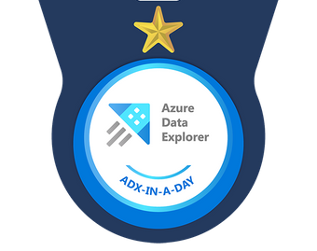

Thank you!
Post your badges on LinkedIn with #adxinaday

